Slide 1
Three Stage Pipeline
MIPS
Karna Pardheev Sai-21110097
R B Rudreshwar -21110172
Github Repo:https://github.com/saikarna913/3_Stage_Pipelined_MIPS/tree/main

Slide 2
3 Stage Pipelined MIPS
Modified the single-cycle MIPS architecture into a 3-stage pipelined MIPS.
A forwarding unit was incorporated to manage RAW hazards.
The pipeline now consists of three stages: instruction fetch, execute, and write-back.
Fetch, it fetches the instruction and decodes it and store the all the values require in pipe register which is of 118 bits.
Execute, execute the instruction and write it values to next pipe register
Write Back, writes back the value to the register file.

Slide 3
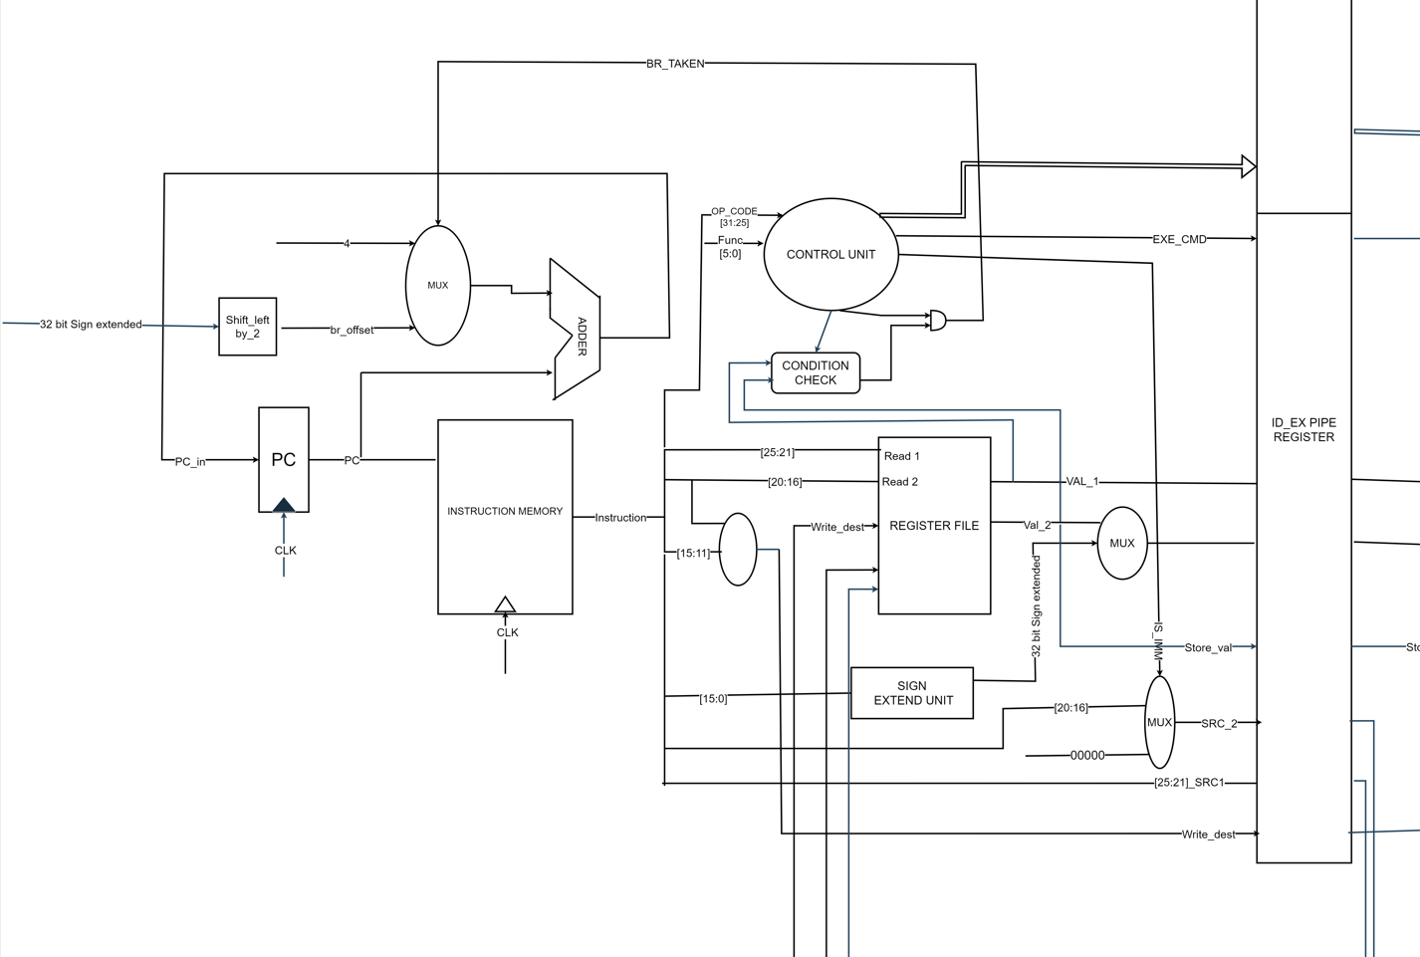
Instruction Fetch

Slide 4
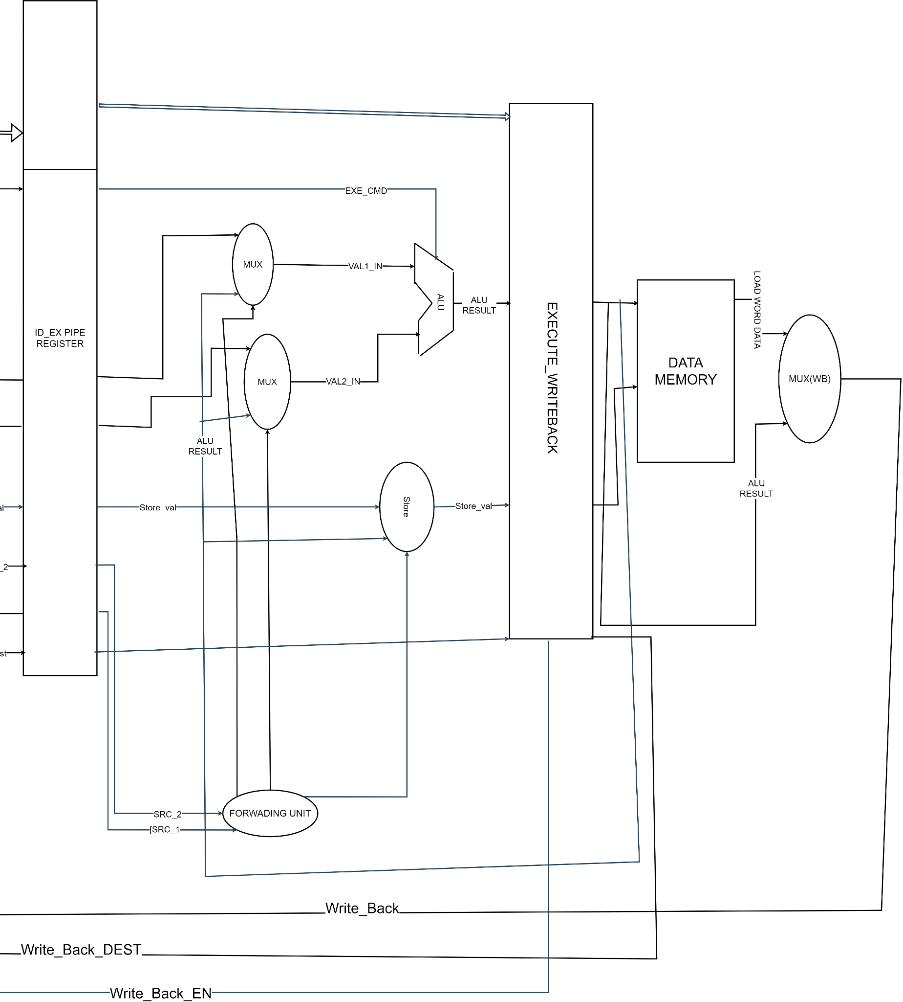
Execute

Slide 5
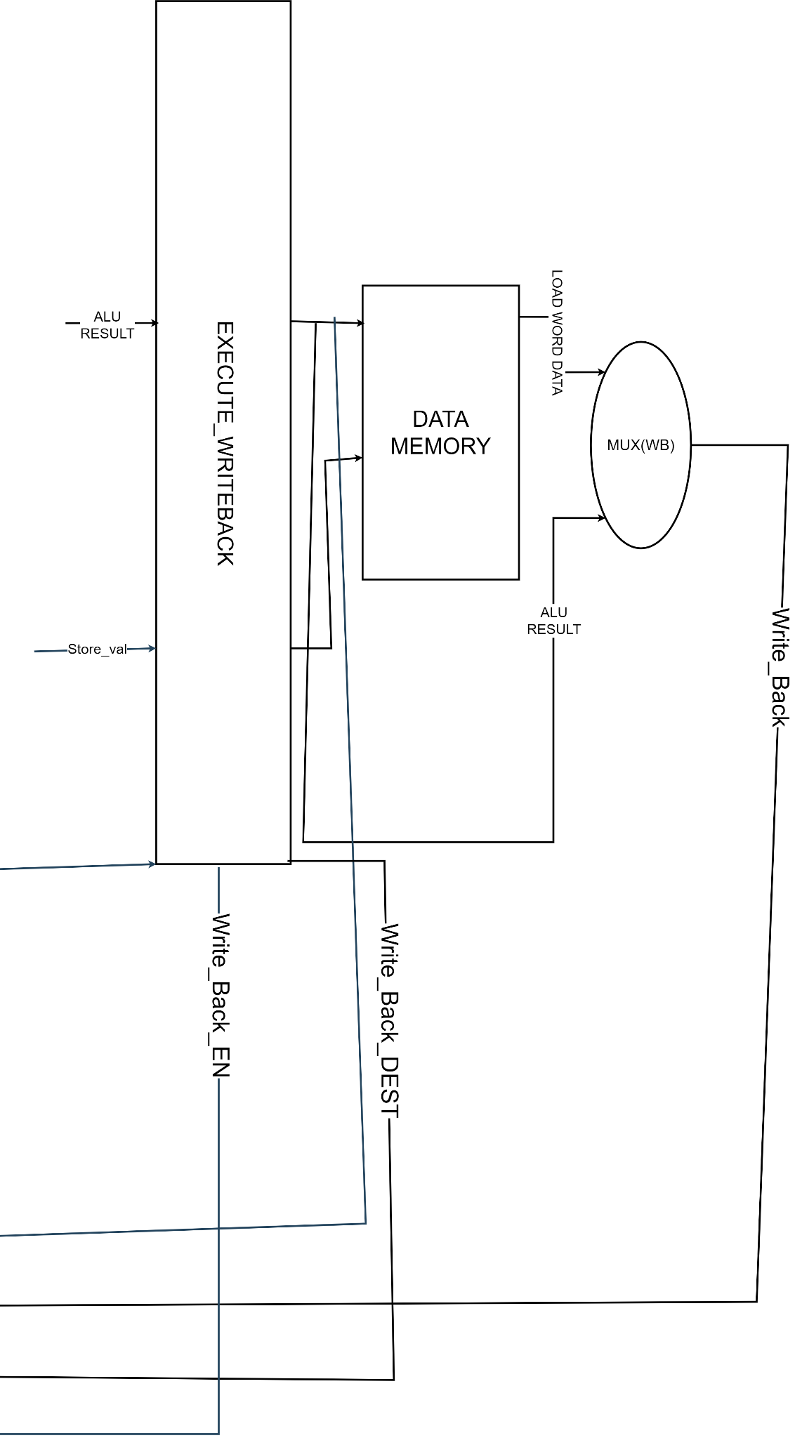
Write Back

Slide 6
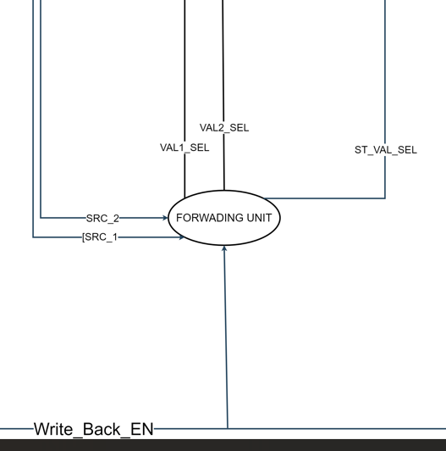
Forwarding Unit
`include "defines.v"
module forwarding_EXE (
input [`REG_FILE_ADDR_LEN-1:0] src1, src2,
input [`REG_FILE_ADDR_LEN-1:0] ST_src_ID,
input [`REG_FILE_ADDR_LEN-1:0] dest_ID,
input WB_EN,
output reg val1_sel,
output reg val2_sel,
output reg ST_val_sel
);
always @(*) begin
val1_sel = 0;
val2_sel = 0;
ST_val_sel = 0;
if (WB_EN) begin
if (src1 == dest_ID) val1_sel = 1; // Forward src1 from EX stage
if (src2 == dest_ID) val2_sel = 1; // Forward src2 from EX stage
end
if (WB_EN && ST_src_ID == dest_ID) begin
ST_val_sel = 1; // Forward the value for store operation
end
end
endmodule // forwarding_EXE

Slide 7
